Slide 1


Bholabhai Patel College of Computer Studies- BCA
(A constituent College of Kadi Sarva Vishwavidyalaya)
Project - BCA 508
(Specialization- {Robotics} )
Smart Wristband to monitor Corona Patients
Under the Supervision of : Dr.Rebakah ma’am

Slide 2
Sr. No | Name | Enrollment No
1 | Prajapati Himil
2 | Patel Rachit
3 | Upadhyay Aditya

Slide 3
Index
Sr. No | Content Name | Slide numbers
1 | Project title | 1
2 | Project objectives/scope | 3, 4
3 | Study of existing system
4 | System requirements specification
5 | Comparision of microcontrollers
6 | Architecture of Microcontroller
7 | Circuit connection
8 | Types of sensors used
9 | Implementation of project
10 | Real life applications
11 | Future enhancements

Slide 4
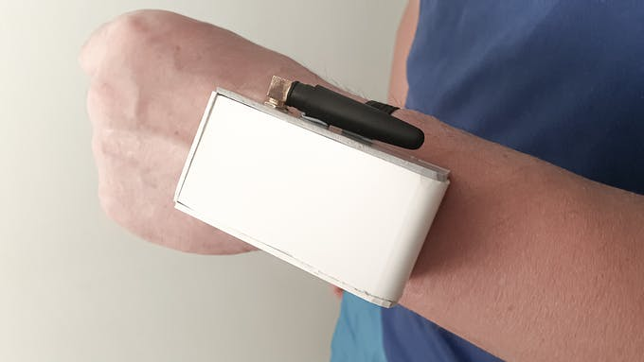
People with weak forms of virus, only show weak symptoms but the health of these patients can worsen in a matter of hours.
Their health must be monitored in detail.
Some countries have crowded their hospitals with such patients, whereas others have sent them to self-isolate but it is difficult to monitor their condition.
Some patients do not comply to quarantine norms and leave their homes these people can cause infections to other people.
Smart Wristband is a wristband held device that monitors the patient’s vitals and geolocation.
Img 1

Slide 5
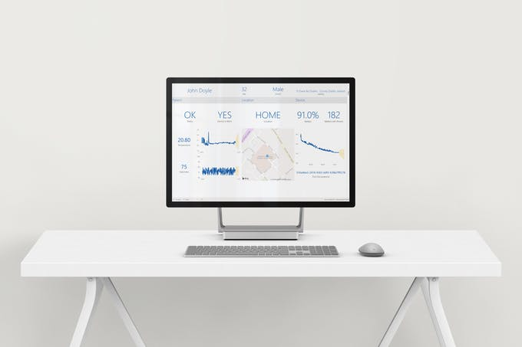
Elevated temperature and irregular heart rate are signs of the progression of virus.
The smart Wristband will stream this data securely to the hospital monitoring the patient.
The device will also track the location of the user ensuring that they are at home at all times.
All of this data is stored in scalable database allowing thousands of these devices to be deployed to various places.
The hospital will have access to a dashboard where they will be able to see the health of all patients being monitored at a glimpse.

Slide 6
Benefits of using Smart Wristband
Ensuring that patients sent to self-isolate are staying at home.
Monitoring the patients’ vitals without the need of them being in hospital.
Liberating space in hospitals for people with severe manifestations of the virus.
Alerting doctors to the state of all patients in self-isolation 24/7.
Providing a comfortable monitoring solution for the patient.
Providing the hospital with a forecast of the patient’s health.
Informing the patient about their health through a desktop dashboard.
Cost effective and scalable.

Slide 7
Comparison between various smart wristbands
Apple Watch series 6 | Fitbit sense | Samsung galaxy watch 3 | Amazfit GTS 2/GTR 2 | Fitbit charge 4 | Mi band 5
Has blood oxygen sensor | Has blood oxygen sensor | Has blood oxygen sensor | Has blood oxygen sensor | Does not have blood oxygen sensor | Does not have blood oxygen sensor
Has ECG sensor | Has ECG sensor | Does not have ECG sensor | Has ECG sensor | Does not have ECG sensor | Does not have ECG sensor
Has accelerometer | Has accelerometer | Has accelerometer | Has accelerometer | Has accelerometer | Has accelerometer
Has microphone | Has microphone | Has microphone | Has microphone | Does not have microphone | Does not have microphone

Slide 8
Apple watch series 6 | Fitbit sense | Samsung galaxy watch 3 | Amazfit GTS 2/GTR 2 | Fitbit charge 4 | Mi band 5
Has gyroscope | Has gyroscope | Has gyroscope | Has gyroscope | Has gyroscope | Has gyroscope
Has GPS | Has GPS | Has GPS | Has GPS | Has GPS | Does not have GPS
Price : - 43,000 | Price: - 23,000 | Price:- 26,100 | Price: - 13,000 | Price:- 11,000 | Price:- 2,500
as

Slide 9
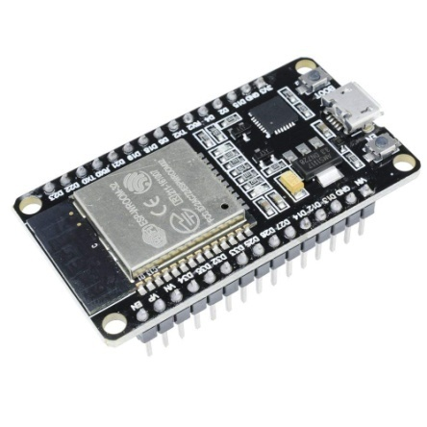
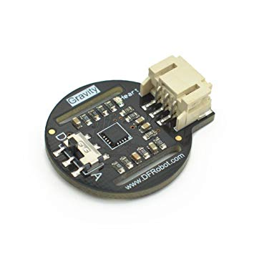
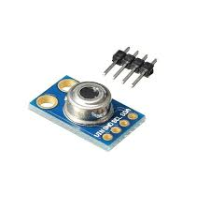
Hardware used
ESP 32
Heartrate sensor (SKU SEN0203)
MLX90614 ESF
Img 2
Img 3
Img 4

Slide 10
NodeMCU ESP 8266 | ArduinoUno | ESP 32
Contains ESP8266 microcontroller. | Contains Atmel Atmega328P microcontroller. | Successor to ESP 8266. Has an extra CPU core.
The operating voltage of is 3.3V. Can work longer when connected with battery. | Operating voltage is 5V. | Operating voltage 3.3V.
Have lesser analog pins than arduino, usually 1 or 2. | Arduino has more analog I/O pins. | Has more analog I/O pins.
Microcontroller has higher clock speed than Atmega328P. | Microcontroller has lower clock speed. | Has higher clock speed.
Has a Wi-Fi chip on board. | Does not have a Wi-Fi chip on board. | Has a Wi-Fi chip on board. Faster Wi-Fi data transfer than ESP 8266.
Is smaller is size. | Is larger in size. | Smaller is size
More digital I/O pins with PWM. | Less digital I/O pins with PWM. | More digital I/O pins.
Does not have bluetooth capability. | Does not have bluetooth capability. | Has bluetooth capability.
Does not provide this functionality. | Does not provide this functionality. | Can decide which pins are I2C, UART, SPI.

Slide 11
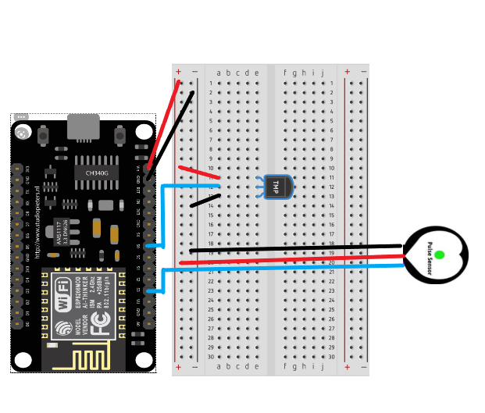
ESP32 Circuit Diagram
(Fig 3)

Slide 12
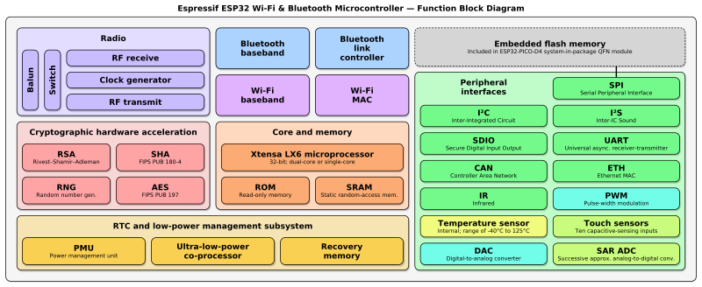
ESP-32 function block diagram
(Fig. 1)
The Function Block Diagram is a graphical language for programmable logic controller design, that can describe the function between input variables and output variables. A function is described as a set of elementary blocks. Input and output variables are connected to blocks by connection lines.

Slide 13
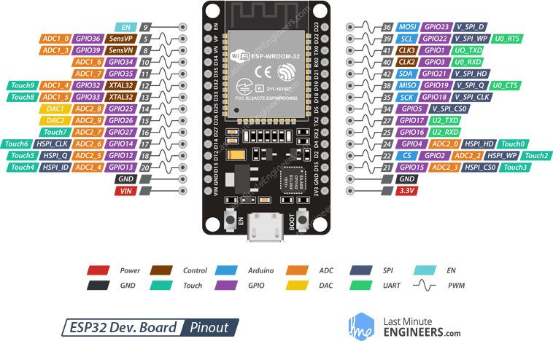
ESP32 pin layout
(Fig 2)

Slide 14
How it works
Runs ever 5 mins
Sync GNSS
Get location
Get Battery level
Device is worn
Get temperature and heartrate
Package Data
Send Data
(Fig 4)

Slide 15
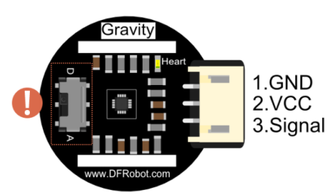
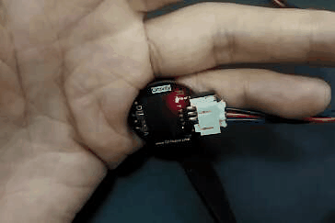
Heart rate sensor (SKU SEN0203 by DFRobot)
Comes with an option to send both analog or digital data.
This sensor is a pulse sensor which is developed based on PPG (PhotoPlethysmoGraphy) techniques. This is a simple and low-cost optical technique that can be used to detect blood volume changes in the microvascular bed of tissues.
Img 5
Img 6

Slide 16
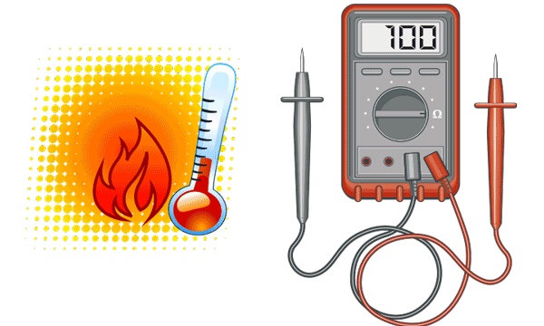
Infrared temperature sensor (MLX90614 ESF)
The MLX90614 ESF is an Infra-Red thermometer for non-contact temperature measurements.
The sensor works by focusing the infrared energy emitted by an object
Into one or more photodetectors.
The resulting change in the photodetectors resistance is then transmitted to the ESP 32.
Img 7

Slide 17
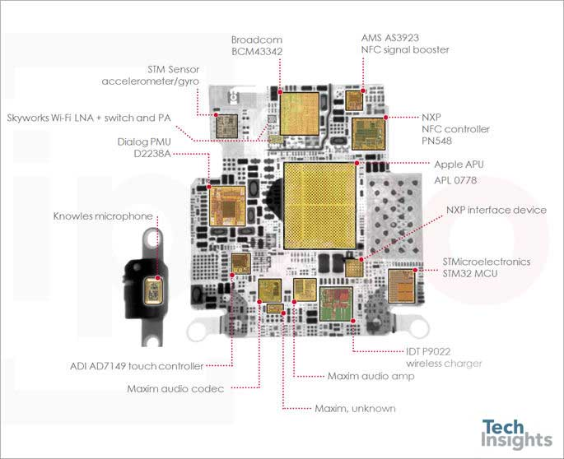
Apple watch series 6
Img 8

Slide 18
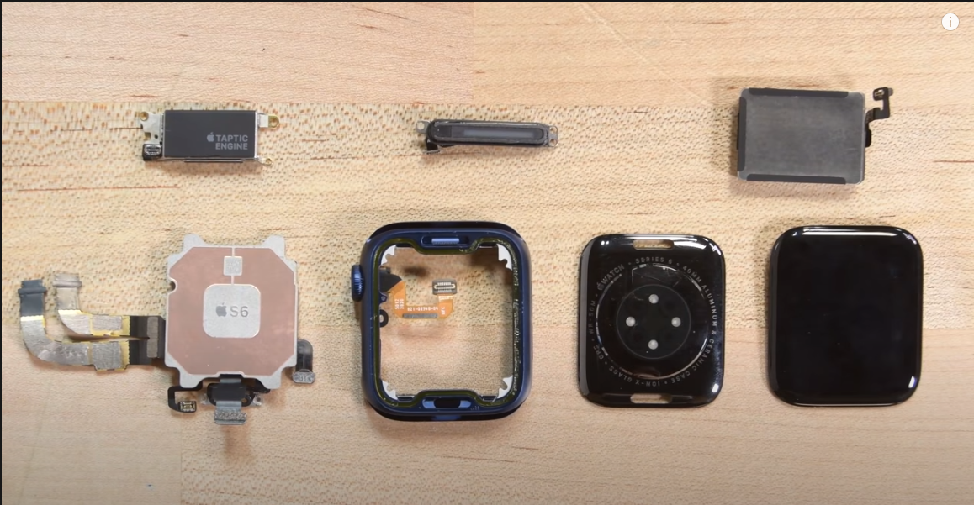
Img 9

Slide 19
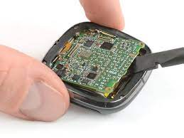
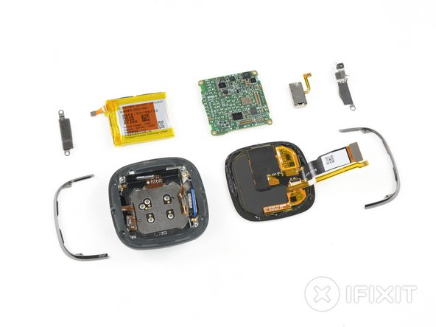
Fitbit sense
Img 9

Slide 20
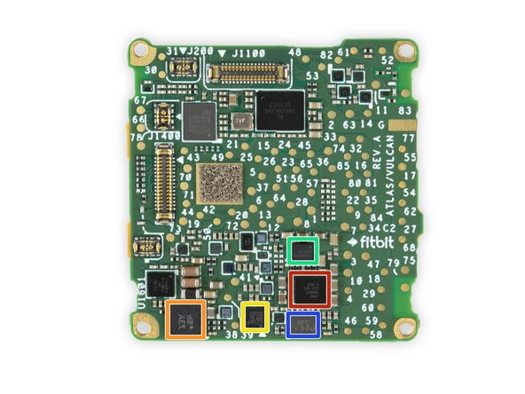
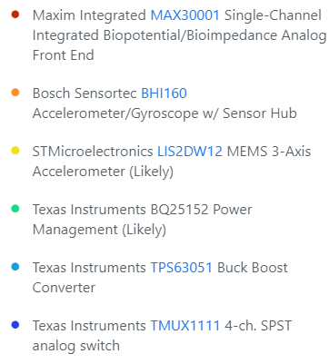
Img 10

Slide 21
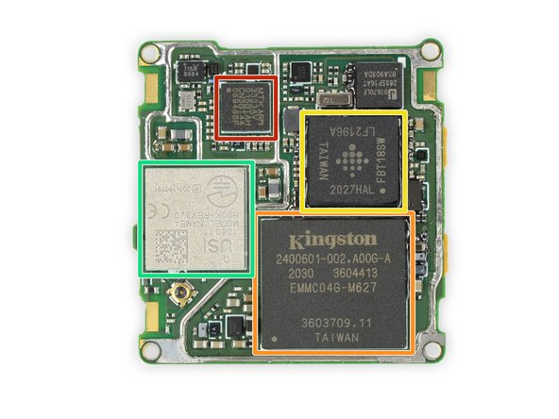
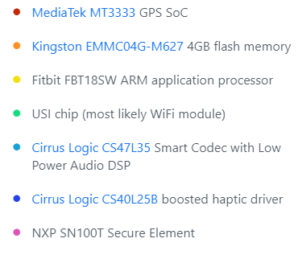
Img 11

Slide 22
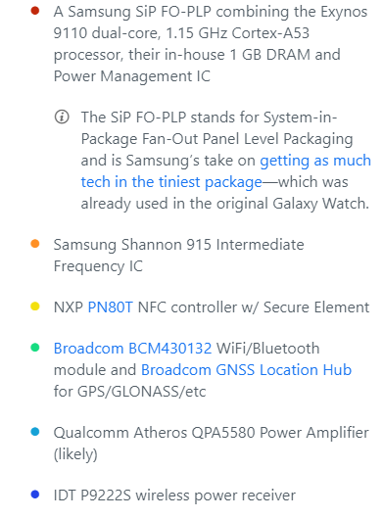
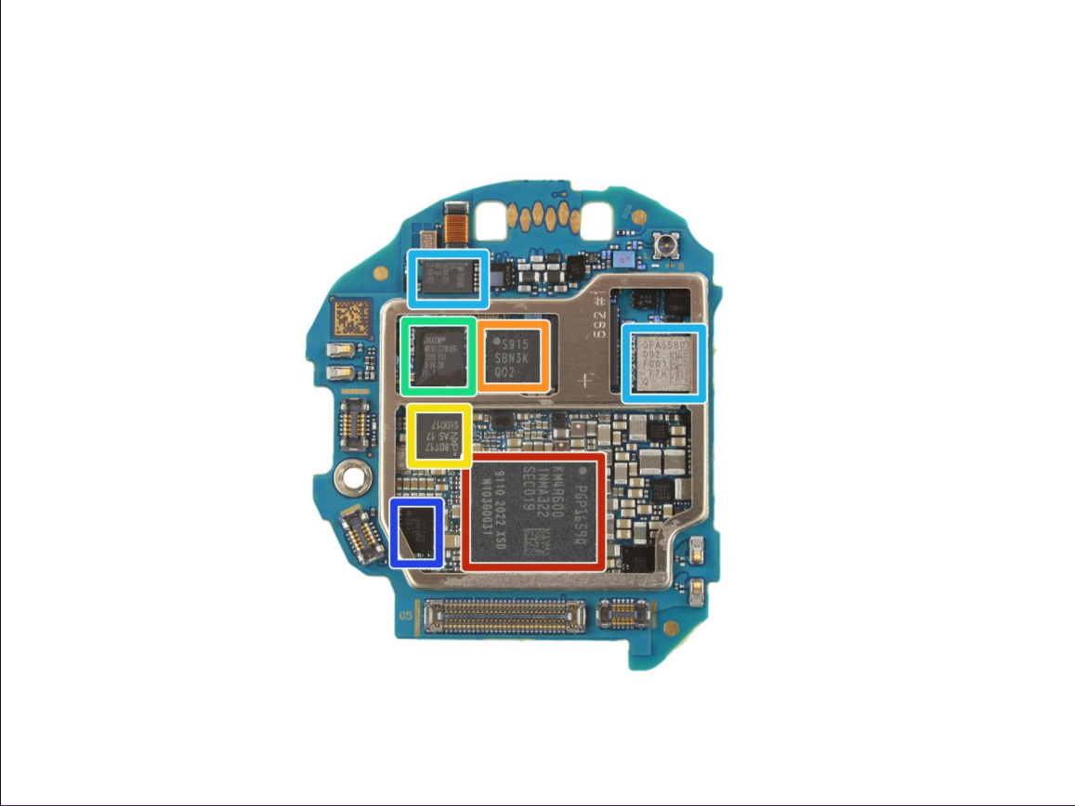
Samsung galaxy watch 3
Img 12

Slide 23
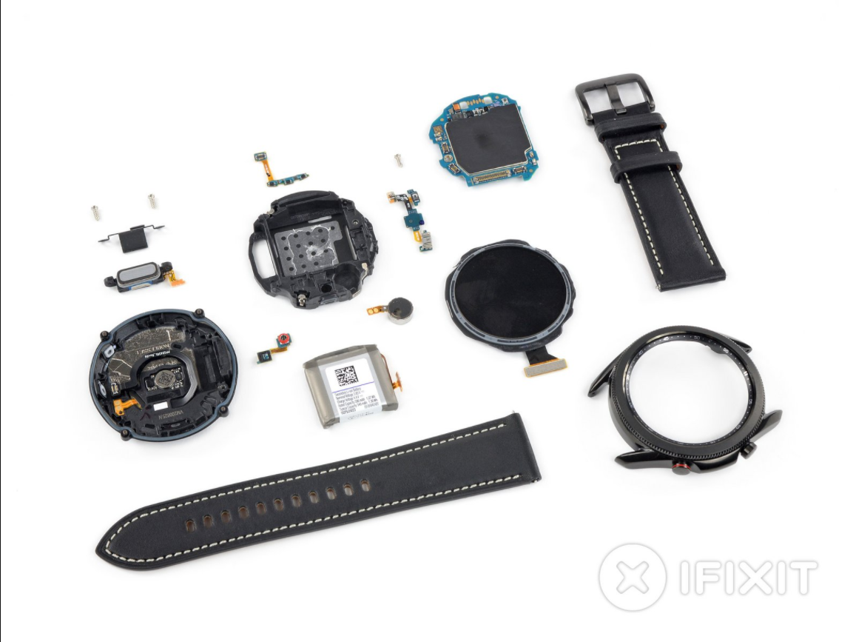
Img 13

Slide 24
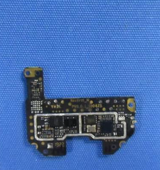
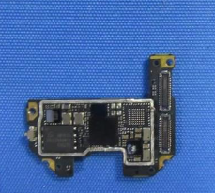
Amazfit GTS 2
Img 14

Slide 25
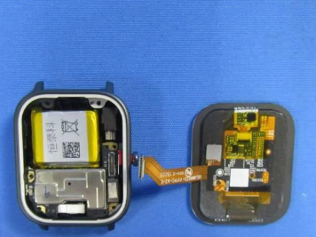
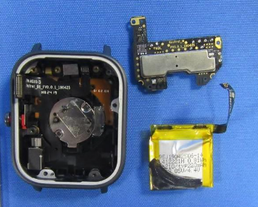
Img 15

Slide 26
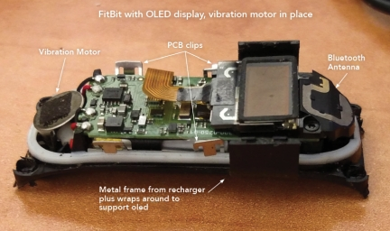
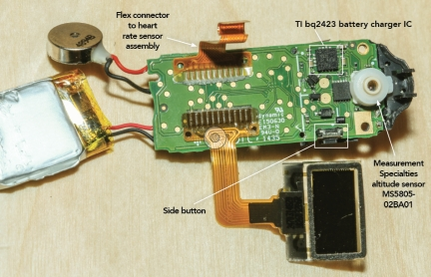
Fitbit Charge 4
Img 16

Slide 27
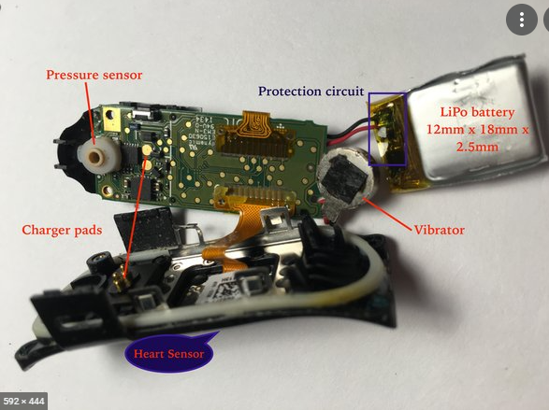
Img 17

Slide 28
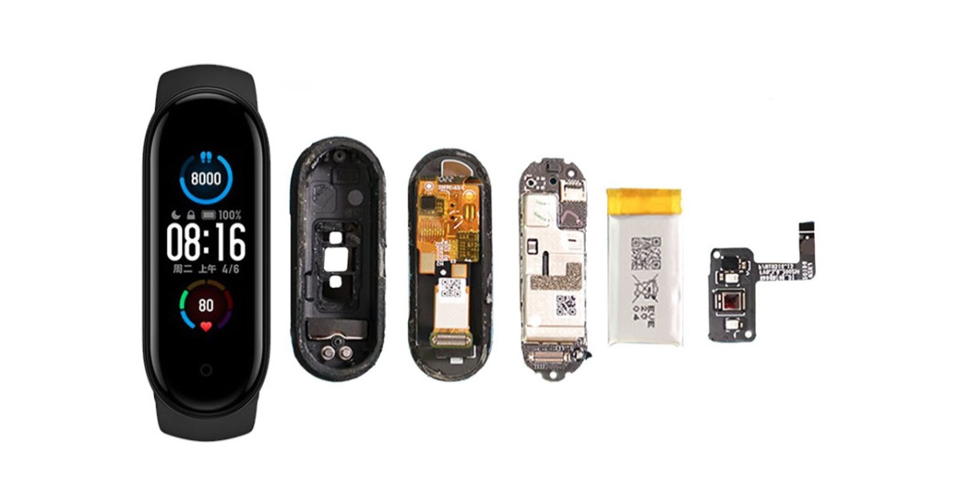
Mi Band 5
Img 18

Slide 29
Smart Wristband

Slide 30
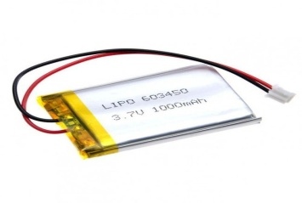
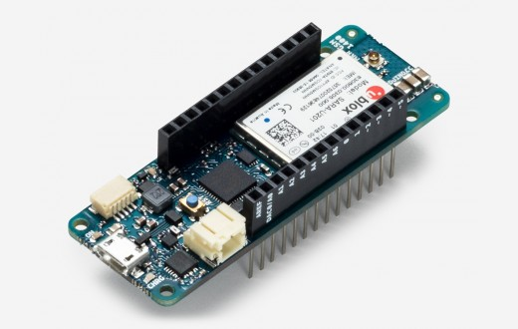
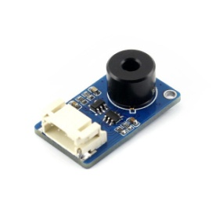
Img 19

